Slide 1

LM Big Data Management in Finance (36320) Birmingham Business School Fundamentals of Machine Learning
Dr. Animesh Acharjee

Slide 2
Review Questions
What is machine learning?
Why machine learning is important in the financial technology?
What is the difference between supervised vs unsupervised learning?
What are the two basic ingredients for machine learning methods to learn the rules?
What are the training and testing samples?

Slide 3
Regression

Slide 4
Regression: Basics
Why we use regression?
Modeling relationship between variables
Predict outcome of one variable as a function of others
Investigate the relative importance of the predictors
Assumptions : Linearity, Homoscedasticity, Independence, Normality
Types of regression
Linear
Simple linear
Multiple linear
Nonlinear/Curvilinear

Slide 5
Regression: Basics
y=Dependent / response / outcome
X=Independent / regressor / predictor
=Random variable representing the result of both errors in model specification and measurement.
In the figure
Number of observations (n)=10
Number of response variables (y) =1
Number of predictor variables (X) =1
How one variable changes with another
How “X” and “y” are behaving

Slide 6
Regression: One example
Here:
y = Response
x₁ = Predictor 1
β₁
y (Response) = β₀ + β₁* X₁ + Error
Slope / Coefficient/ Weights

Slide 7
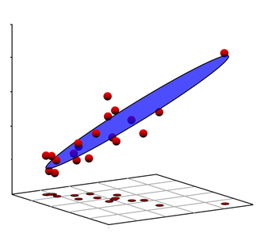
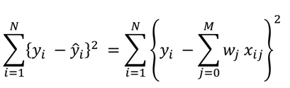
Multiple linear regression
Same example but with x₂:
y = Response
x₁ = Predictor 1
x₂ = Predictor 1
y
Regression Equation : Surface
y = β₀ + β₁* X₁+ β₂ * X₂ + Error
x₂
x₁
If nr. of variable= “p”, then
More general Equation: multidimensional surface
y = β₀ + β₁*X₁+ β₂*X₂+ β₃*X₃… + β_{p}*X_{p}+ Error
Question:
Do you see any problem / Issue in this example?
Or in closed form

Slide 8
Multicollinearity
X₁ and X₂might be correlated
Exact or near linear relationships between the x variables
Also called as : collinearity, near-collinearity or ill-conditioning
What are the consequences?
Regression coefficients
Unstable (sensitive to small changes)
Not uniquely defined
Have high variance
Coefficients can get the wrong sign
Absolute values of regression coefficients can be absurdly high
Impossible to interpret individually
Relative importance of variables cannot be estimated reliably

Slide 9
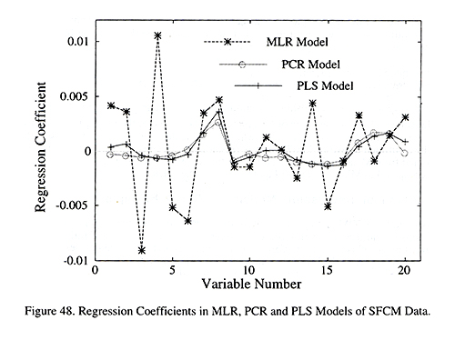
Bouncing betas
Consequences of Multicollinearity
The Elements of Statistical Learning: Data Mining, Inference, and Prediction ; Trevor Hastie, Robert Tibshirani, Jerome Friedman

Slide 10
Multicollinearity
Always occurs when
More variables (p) than objects (n) (p>n)
Therefore
Normal multiple linear regression not possible !
Traditional solutions
Collect more data
Takes lots of time, money
Sometime impossible because of logistics (Project plan)
Use a set of variables p_{subset} < n
Filter on quality criteria: ok
Still p >> n
Do not want to remove more if not known whether important

Slide 11
Also possible solutions
Use selected variables based on “some” criteria
Filter first on univariate methods (t-test, correlation, ANOVA)
Problem
Assumption is variables are independent
Multiple testing
Dimension reduction (PCA, clustering)
Machine learning methods
Penalized methods

Slide 12
Practical

Slide 13
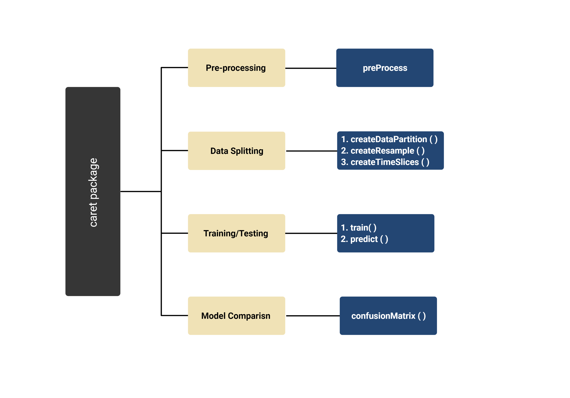

The caret package (short for Classification And REgression Training

Slide 14
How to pre-process using caret?
Pre-processing is a important step in the data analysis
We need to standardize to make every variable in the same scale
Data becomes more like gaussian distribution
We can do it using following function
fit.lm2 <- train(medv~., data=training, method="lm", metric="RMSE", preProc=c("center", "scale"), trControl=control)

Slide 15
#Install the Caret Package and its depencencis if it is not already installed
if (!require("caret")) install.packages("caret", dependencies=T)
#Load the Package
library("caret")
install.packages("mlr")

Slide 16
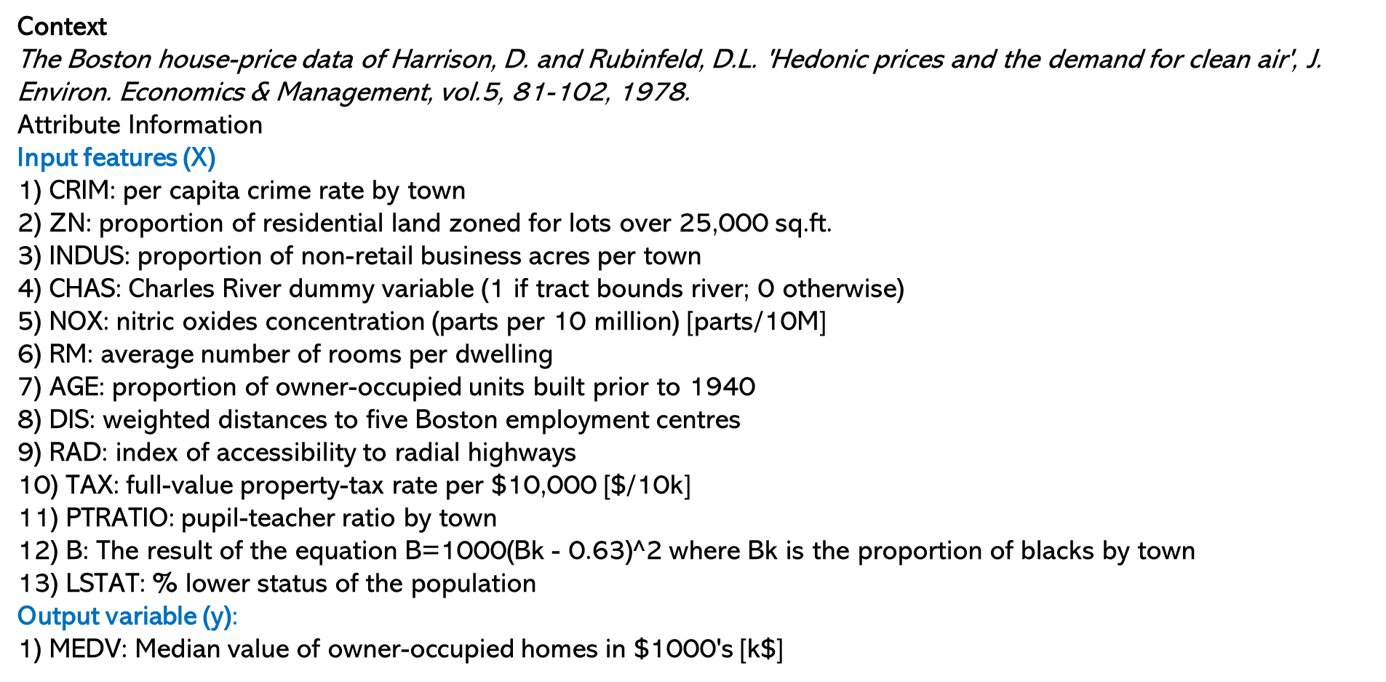
#load packages
library(caret)
library(mlbench)
# load dataset
data(BostonHousing)
# cheking the dimensions
dim(BostonHousing)
head(BostonHousing)
# create 80% and /20% for training and validation datasets
set.seed(9)
# create a partition on the data
validation_index <- createDataPartition(BostonHousing$medv, p=0.80, list=FALSE)
training <- BostonHousing[validation_index,]
dim(training)
# dimension of the validation data
validation <- BostonHousing[-validation_index,]
# dimension of the validation data
dim(validation)

Slide 18
# train a model and summarize model
control <- trainControl(method="cv", number=10)
# Create model on training set
fit.lm <- train(medv~., data=training, method="lm", metric="RMSE", trControl=control)
print(fit.lm)
print(fit.lm$finalModel)
# predict on test set
predictions <- predict(fit.lm, newdata=validation)
write.csv(predictions, "predictionsModel.csv ")

Slide 19
Methods
Machine learning methods
Regularization
LASSO
Elastic Net
Ridge
Decision tree
Random Forest
XGBoost
Kernel Based
SVM
Neural Network based
ANN
Deep learning
LSTM

Slide 20
Penalization / Regularaization/ Sparse/ Shrinkage methods Lasso, Ridge and Elastic Net

Slide 21
Recollect: Multiple linear regression
Same example but with x₂:
y = Response
x₁ = Predictor 1
x₂ = Predictor 1
y
Regression Equation : Surface
y = β₀ + β₁* X₁+ β₂ * X₂ + Error
x₂
x₁
If nr. of variable= “p”, then
More general Equation: multidimensional surface
y = β₀ + β₁*X₁+ β₂*X₂+ β₃*X₃… + β_{p}*X_{p}+ Error
Question:
Do you see any problem / Issue in this example?
Or in closed form

Slide 22
Why is regularization important?
Regularization favours simpler models to more complex models to prevent your model from overfitting to the data.
How so?
They address the following concerns within a model:
Variance-bias trade-off
Multicollinearity
Sparse data handling(i.e. the situation where there are more observations than features)
Feature selection
An easier interpretation of the output.

Slide 23

Type of methods
Penalization Methods
Variable Selection Methods
LASSO (Tibshirani R, 1996)
Elastic Net (Zou H, 2005)
Ranking Methods
Ridge (Hoerl and Kennard, 1970)
LASSO (Tibshirani R, 1996)
Fused LASSO (Tibshirani and Saunders, 2005)
Grouped LASSO (Yuan M, 2006)
Adaptive LASSO (Zou H, 2006)
Graphical LASSO (Friedman et al., 2007)

Slide 24
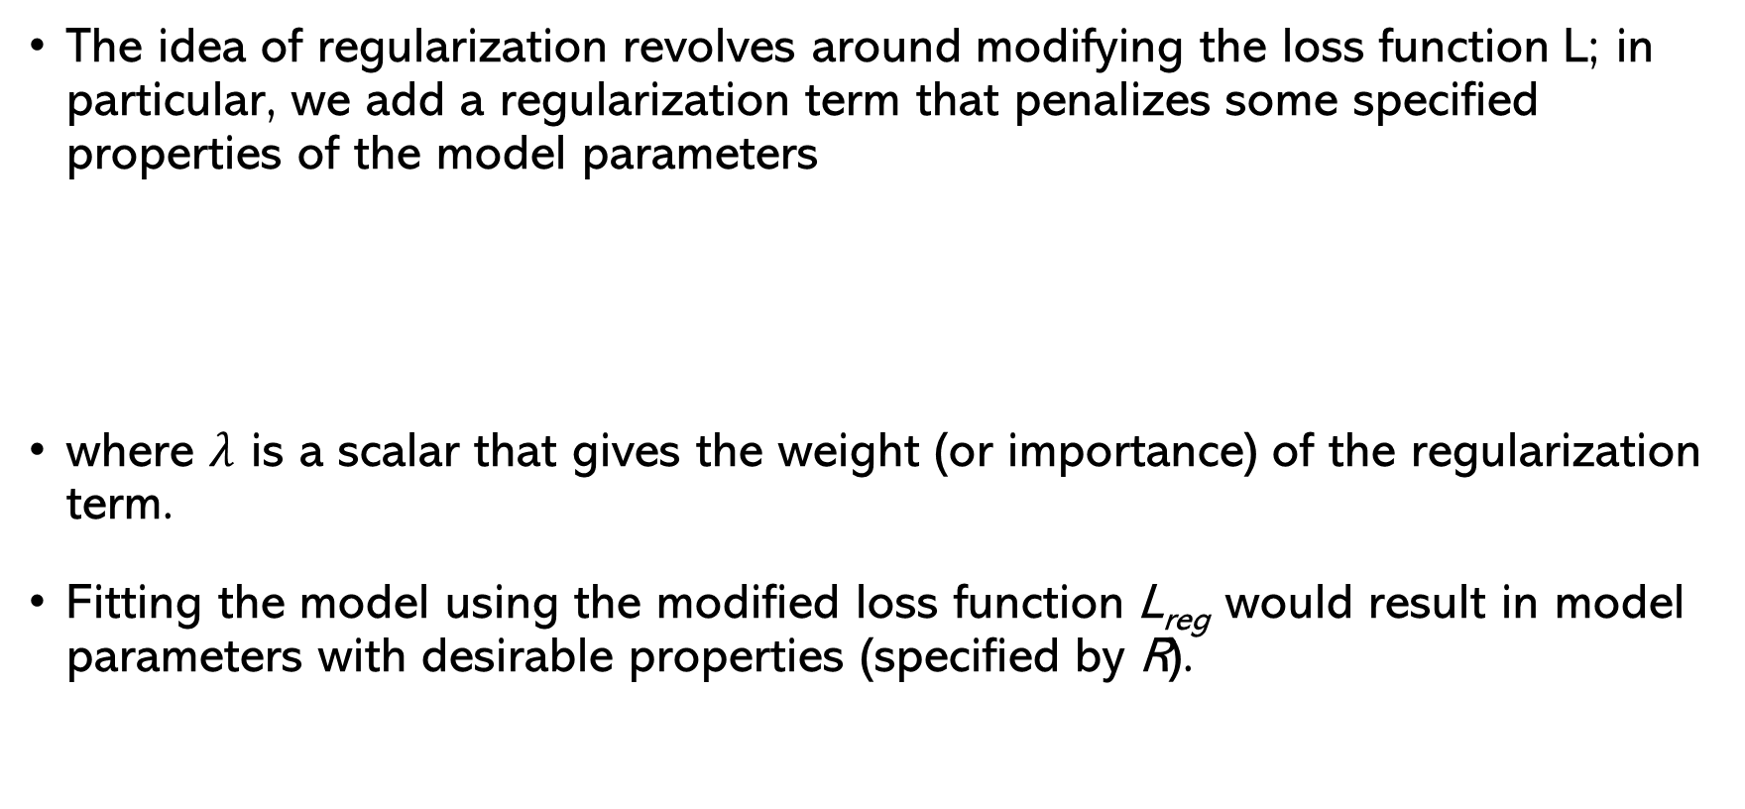
Regularization: An Overview
The idea of regularization revolves around modifying the loss function L; in particular, we add a regularization term that penalizes some specified properties of the model parameters
where $λ$ is a scalar that gives the weight (or importance) of the regularization term.
Fitting the model using the modified loss function L_{reg} would result in model parameters with desirable properties (specified by R).

Slide 25
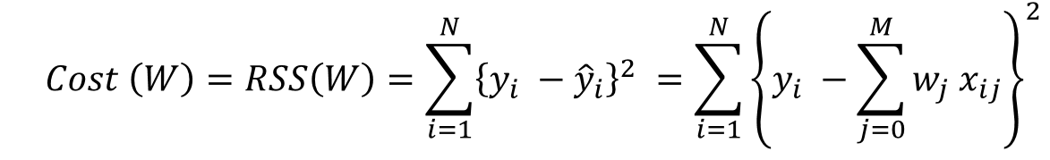
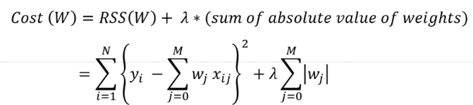
Introduction to LASSO
Recollect least squares for OLS
The OLS equation is also called as objective function/cost function
The residual sum of squares(RSS) plus the sum of absolute value is minimized
LASSO stands for Least Absolute Shrinkage and Selection Operator
LASSO regression performs L1 regularization, i.e. it adds a factor of sum of absolute value of coefficients in the optimization objective.

Slide 26
Properties of LASSO
LASSO (Least Absolute Shrinkage and Selection Operator)
Variable will be selected, depending on λ
λ is called as penalty parameter/ Shrinkage parameter
The value of λ lies between 0 to 1
λ close to 1 means
Heavy penalization
Less variables will be selected
Many variables shrunk to “0” (kicked out from model)
Automatic variable/feature selection !
No grouping of correlated variables
Maximum of “n” variables selected
Bottle neck : Selection of “λ”
Should be estimated from data (Unbiased way)

Slide 27
Ridge Regression
Alternatively, we can choose a regularization term that penalizes the squares of the parameter magnitudes.
Then, our regularized loss function is:
Note that is the square of the l₂ norm of the vector β

Slide 28
Choosing λ
In both ridge and LASSO regression, we see that the larger our choice of the regularization parameter λ, the more heavily we penalize large values in β,
If λ is close to zero, we recover the MSE, i.e. ridge and LASSO regression is just ordinary regression.
If λ is sufficiently large, the MSE term in the regularized loss function will be insignificant and the regularization term will force β_{ridge} and β_{LASSO} to be close to zero.
To avoid ad-hoc choices, we should select λ using cross-validation.

Slide 29
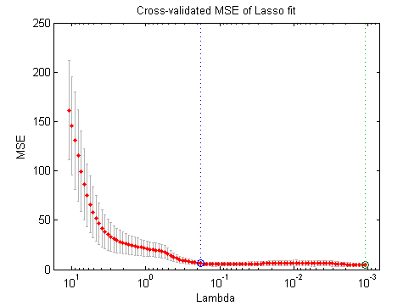
Selection of “λ”
Very critical
Can be optimised
Linear optimization
Nonlinear optimization
The solution of the Ridge/Lasso regression involves three steps:
Select λ
Find the minimum of the ridge/Lasso regression loss function and record the MSE on the validation set.
Find the λ that gives the smallest MSE
MSE
(Mean Square Error)
“λ” (lambda)

Slide 30
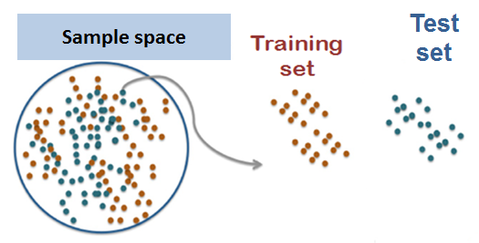
Evaluation
Prediction Function, f(α)
Out of sample error/
Generalized error/MSE
Test set

Slide 31
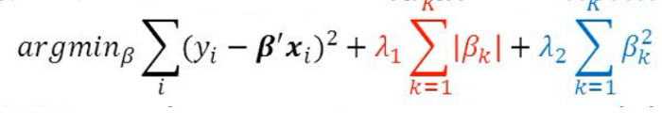
Elastic Net Regression
LASSO
Ridge
Elastic Net produces a regression model that is penalized with both the L1-norm and L2-norm.
The consequence of this is to effectively shrink coefficients (like in ridge regression) and to set some coefficients to zero (as in LASSO).

Slide 32
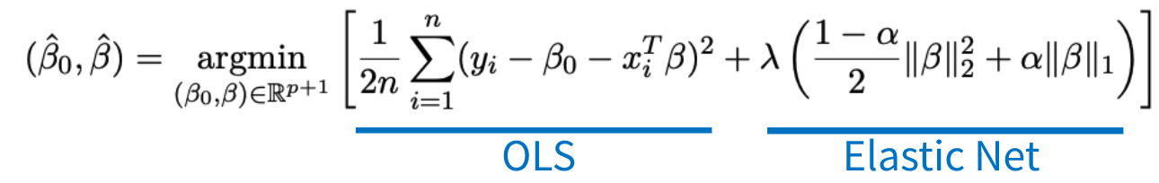
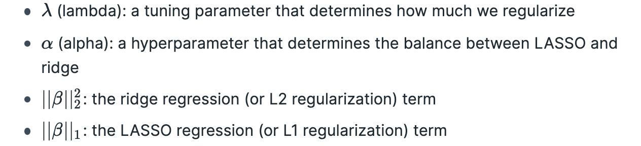
Elastic Net Regression

Slide 33
Elastic Net Regression
The elastic net method performs variable selection and regularization simultaneously.
Groupings and variables selection are the key roles of the elastic net technique.
The elastic net technique is most appropriate where the dimensional data is greater than the number of samples used.

Slide 34
Unsupervised Learning
Clustering
Hierarchical Clustering

Slide 35
Clustering
Clustering = Class discovery
Group attributes/features/variables that behave similarly over a set of samples
‘Guilt by association’
Group observations based on similar features
Clustering = unsupervised classification
Information about grouping is unknown or unused

Slide 36
Variables
Observations
Clustering on variables

Slide 37
Variables
Observations
Clustering on observations/samples

Slide 38
Variables
Observations
Clustering on observations/samples & variables simultaneously=Bi-clustering

Slide 39
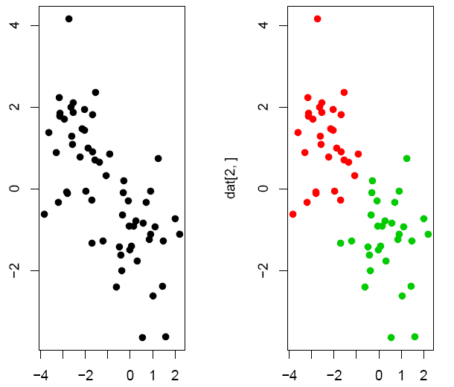
Aim of clustering
A set of objects that are close/similar to each other in some defined aspect(s) and separated from other groups of objects.
Example: green/ red data points were generated from two different normal distributions

Slide 40
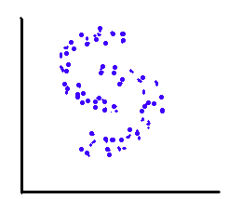
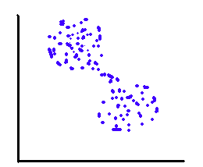
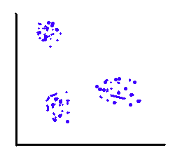
Definition of ‘close’ is not always that obvious

Slide 41
Distance measure and algorithm
Distance measure: Quantification of (dis)similarity of objects.
What do we regard as ‘similar’ ?
How best quantified ?
Cluster algorithm: A procedure to group objects.
Aim: small within-cluster distances, large between-cluster distances.
Procedure to form such groups

Slide 42
Distance/Similarity
Given vectors x = (x₁, …, x_{p}), y = (y₁, …, y_{p})
Euclidean distance
Manhattan distance
Pearson correlation distance

Slide 43
Distance/Similarity
Squared correlation distance
Angular separation / cosine correlation distance

Slide 44
Which distance measure to use?
Euclidean and Manhattan distance both measure absolute differences between vectors.
Manhattan distance is more robust against outliers.
When the variables are measured on different scales it is wise to apply standardization to the observations
Standardization makes Euclidean and correlation distances equivalent

Slide 45
Clustering algorithms
Hierarchical
Agglomerative (UPGMA, single linkage, furthest linkage)
Divisive
Partitioning
K-means
Self organizing maps

Slide 46
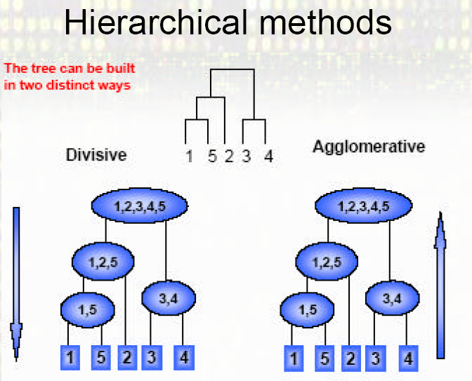
Hierarchical Clustering
Produces a dendrogram (tree)
Avoids pre specification of the number of clusters K
The tree can be built in two distinct ways:
Bottom-up: agglomerative clustering
Top-down: divisive clustering

Slide 47
Agglomerative Hierarchical Clustering
Start with n sample (or p variables) clusters
Each sample is a cluster
At each step, merge two closest clusters
Need a distance/similarity metric
E.g. Correlation, cosine, Manhattan distance, Euclidean distance
And a definition of the between-cluster distance
As soon as clusters consist of more than one element you have to decide what the distance between the clusters is.
Examples of between-cluster distances:
Unweighted Pair Group Method using Arithmetic averages (UPGMA): average of pair wise distances
Single-link (Nearest Neighbour): minimum of pair wise distances
Complete-link (Furthest Neighbour): maximum of pair wise distances

Slide 48
How does it work?
15 clusters
distance

Slide 49
Find pair that is ‘closest’ according to distance measure
14 clusters
distance

Slide 50
Continue with the next closest pair(s)
12 clusters
distance

Slide 51
Next: one that is closest to an earlier pair
12 clusters
distance

Slide 52
Now: one cluster of three elements
11 clusters
distance

Slide 53
Go on a number of times
8 clusters
distance

Slide 54
Very close to two other clusters
8 clusters
distance

Slide 55
Next step
7 clusters
distance

Slide 56
All elements are in groups, but unconnected
6 clusters
distance

Slide 57
Red group
5 clusters
distance

Slide 58
Three groups (but: group identity unknown!)
3 clusters
distance

Slide 59
Two groups left
2 clusters
distance

Slide 60
All elements in one big group
1 cluster
distance

Slide 61
Distances between clusters
Calculation of the distance between two clusters is based on the pairwise distances between members of the clusters.
Complete linkage: largest distance
Average linkage: average distance
Single linkage: smallest distance
Complete linkage gives preference to compact/spherical clusters.
Single linkage can produce long stretched clusters.

Slide 62
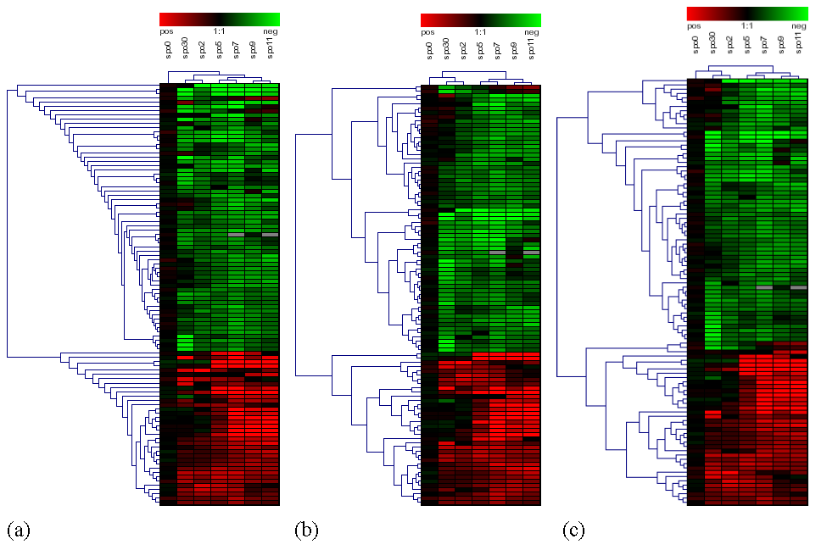
Hierarchical clustering
Single linkage
Complete linkage
Average linkage

Slide 63
Partitioning methods
K-means clustering
Self-organizing maps (SOM)
Bayesian Hierarchical Clustering (BHC)
Partitioning around medoids (PAM)
Model-based clustering

Slide 64
Practical

Slide 65
Clustering
The Dataset
mtcars(motor trend car road test) comprise fuel consumption, performance, and 10 aspects of automobile design for 32 automobiles.
It comes pre-installed with dplyr package in R.

Slide 66
# Installing the package
install.packages("dplyr")
# Loading package
library(dplyr)
# Summary of dataset in package
head(mtcars)
# Finding distance matrix
distance_mat <- dist(mtcars, method = 'euclidean')
# Fitting Hierarchical clustering Model
set.seed(240) # Setting seed
Hierar_cl <- hclust(distance_mat, method = "average")
Hierar_cl
# Plotting dendrogram
plot(Hierar_cl)
# Choosing no. of clusters
# Cutting tree by height
abline(h = 110, col = "green")
# Cutting tree by no. of clusters
fit <- cutree(Hierar_cl, k = 3 )
fit
table(fit)
rect.hclust(Hierar_cl, k = 3, border = "green")

Slide 67
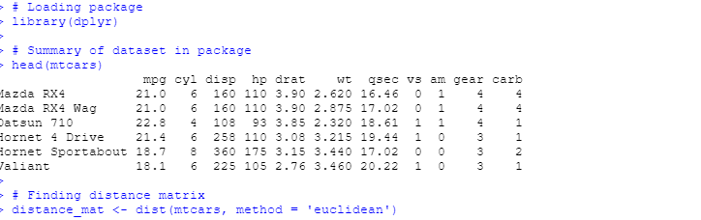
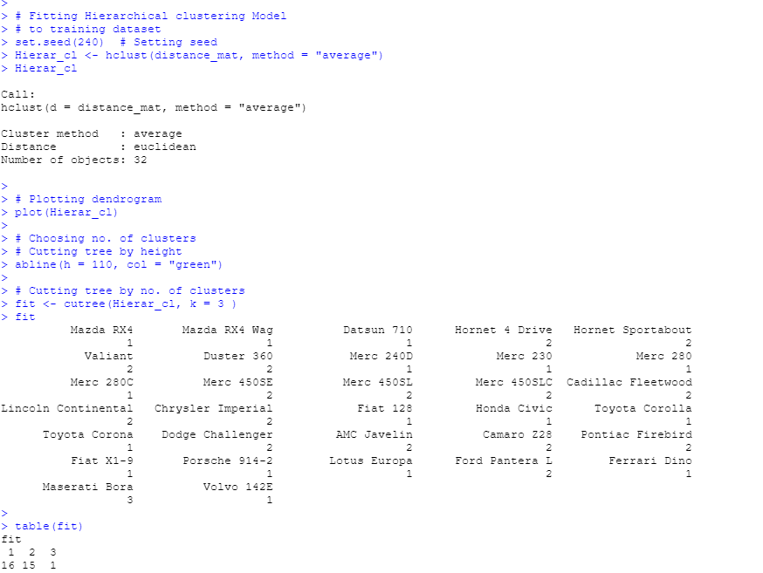

Slide 68
How to decide number of clusters? Missing data imputation
Animesh Acharjee

Slide 69
Methods to decide number of the clusters
The Elbow Method
The Gap Statistic
The Silhouette Method
The Sum of Squares Method

Slide 70
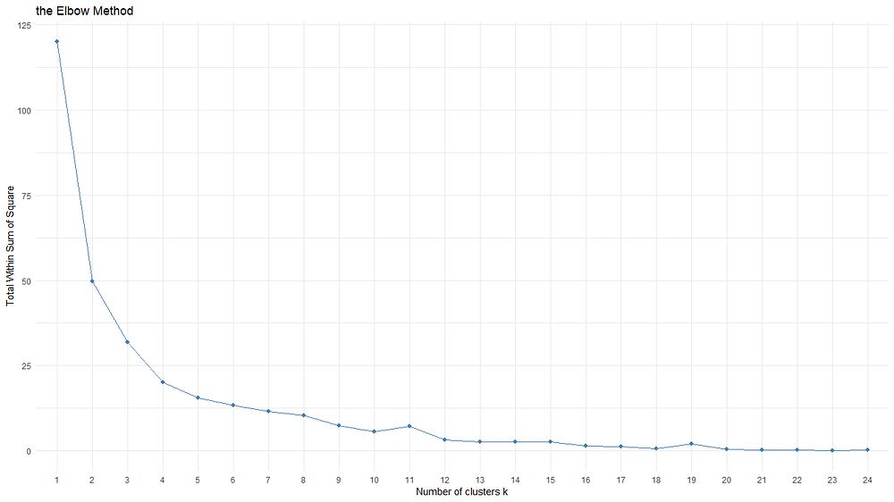
The "Elbow" method
The "Elbow" method is a technique used to determine the optimal number of clusters in a dataset for a k-means clustering algorithm.
It involves running the k-means clustering algorithm on the dataset for a range of values of k (number of clusters) and plotting the within-cluster sum of squares (WCSS) against the number of clusters.
Steps
Choose a range of values for k (number of clusters).
For each value of k, run the k-means clustering algorithm on the dataset and calculate the WCSS.
Plot the WCSS values against the corresponding values of k.
Look for the point on the plot where the rate of decrease in WCSS sharply changes or levels off, forming an "elbow" shape.
The value of k at the elbow is considered a good estimate for the optimal number of clusters.

Slide 71
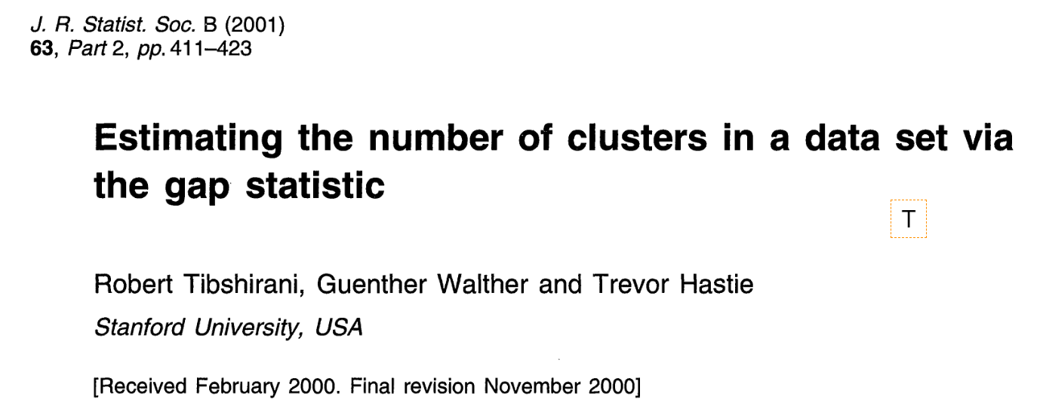
The Gap Statistic
The gap statistic assesses the total within-cluster variation for various values of k by comparing them to their expected values within a null reference distribution of the data.
The optimal number of clusters is estimated as the value that maximizes the gap statistic, indicating a significant departure from the random, uniform distribution of points.
In other words, it identifies the clustering structure that deviates most from random chance.

Slide 72
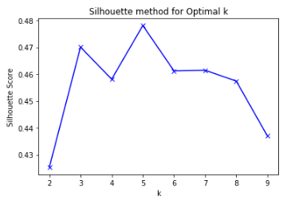
The Silhouette Method
The Silhouette Method is a way of evaluating the effectiveness of clustering in a dataset.
The Silhouette Score for each data point is then computed using the similarity and dissimilarity measures.
The score ranges from -1 to 1.
A high Silhouette Score (close to 1)
indicates that the data point is well-matched to its own cluster and clearly separated from other clusters.
A low Silhouette Score (close to -1)
suggests that the data point may be assigned to the wrong cluster, as it is more similar to points in a neighbouring cluster.

Slide 73
The Sum of Squares Method
Sum of Squares Within Clusters (SSW):
For a given number of clusters (k), the Sum of Squares Within Clusters (SSW) is calculated.
SSW measures the total squared distance of each data point within its assigned cluster from the cluster's centroid (center point).

Slide 74
R packages
Excellent packages for clustering
NbClust
Clustree
cValid
https://www.rdocumentation.org/packages/NbClust/versions/3.0.1/topics/NbClust

